Slide 1
Are Stuck in Confusion?
Let’s get to a conclusion with AVID Tutorials
Notes:
Good evening!
My name is___________________ and
I am a _________ grade AVID student
I’m a future graduate of ___________ college/ or I am a future ____________ (career).

Slide 2
In this session you will:
Learn the role of the Tutorial Request Form (TRF) in pinpointing confusion.
Observe an AVID Tutorial in action.
Understand how students use questioning to resolve their problems.
Notes:
Today, in the “Are YOU stuck in confusion, lets get to a conclusion with AVID tutorials!” workshop you will:
Learn about the importance of the Tutorial Request Form (TRF) and how the TRF helps students identify their point of confusion
Observe an avid tutorial in action and find out how students collaborate and help each other succeed in their academic classes.
At the end, we believe you will be able to use these skills at home to help your child with homework and various assignments. We hope you enjoy our tutorial workshop.

Slide 3
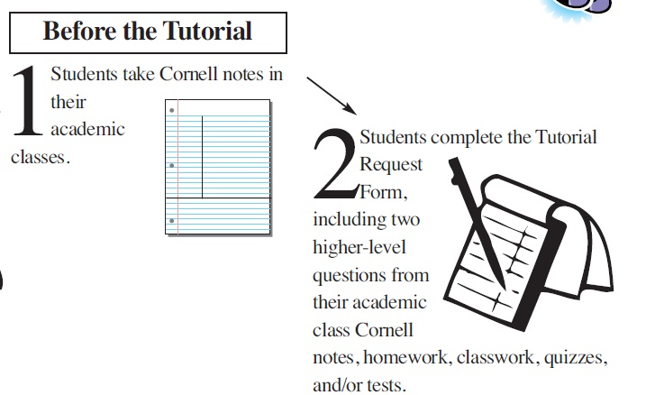
The Tutorial Process
Notes:
In step 1, students take Cornell-Notes in academic classes and participate in all lessons throughout the day.
Step 2 occurs the night before the tutorial. Students are required to complete the Tutorial Request Form (TRF) at home with resources such as quizzes, tests, notes, and HW
Completing the TRF helps students identify what they know about their problem and where they get stuck.
Narrator: every Monday and Wednesday night students are responsible for completing there tutorial request form (trf). Students are expected to go through notes and various assignments to identify a point of confusion. Once a student has there point of confusion they create a question to go along with it. Once they have there question they begin filling out their trf. The trf consists of a question, what they know abut there question, important definitions, and pre work leading up to there point of confusion. A trf can be for any academic subject your students take including science, social studies, math, language arts, and Spanish if your students in the 8th grade.

Slide 4
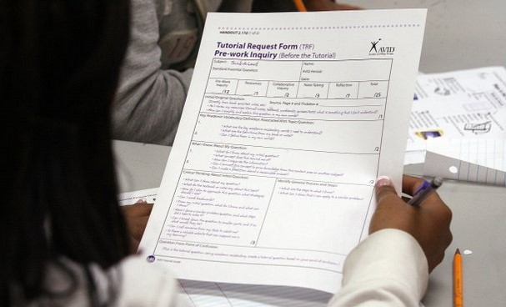
Tutorial Request Form
Notes:
Narrator: every Monday and Wednesday night students are responsible for completing a tutorial request form (trf). Students are expected to go through notes and various assignments to identify a point of confusion. Once a student has there point of confusion they create a question to go along with it. Once they have there question they begin filling out their trf. The trf consists of a question, what they know abut there question, important definitions, and pre work leading up to there point of confusion. A trf can be for any academic subject your student takes including science, social studies, math, language arts, and Spanish/French if your student is in 8th grade.

Slide 5
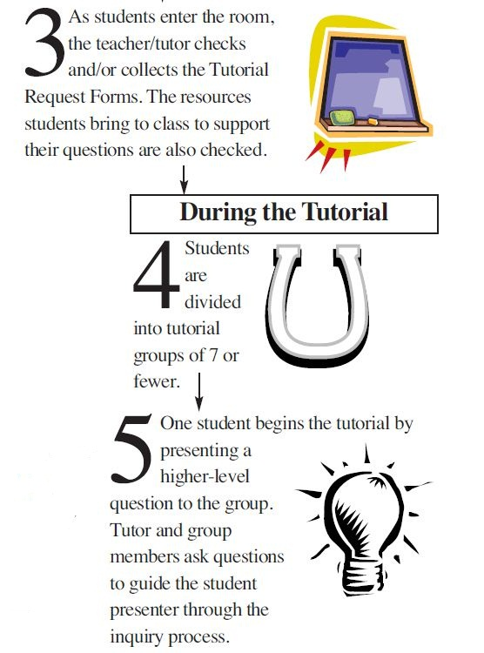
The Tutorial Process
Notes:
Narrator: Tutorials are every Tuesday and Thursday in the avid classroom. Students begin by walking in and handing the tutor their TRF. Once a student volunteers he/she goes to the board writes their question and gives a 30-second speech. In this speech, the students share their pre-work from the TRF and explain their point of confusion (P.O.C). A student’s point of confusion is what they don’t understand about that specific topic their question is on. When the student at the board states there point of confusion it tells the group what they need help on and how to help them.
Demo: tutor: Hello kids!
Tutor: let me see your TRF and your resources.
Tutor: who would like to go first.
Student 1: I do!
Tutor: okay go ahead.
Student 1: my higher level question is, how can I apply the steps to solve a two-step equation.
Student 2: what is your point of confusion?
Student 1: I understand how to solve a one step but once I bring down the variable to start a two step I get lost.

Slide 6
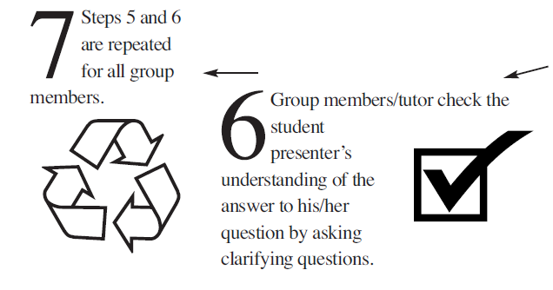
The Tutorial Process
Notes:
Narrator:
After the tutorial begins students start asking questions to help their peer figure out their point of confusion. Asking questions helps the student figure it out on their own without receiving the answer.
Demo:
*Student 2 starts asking student one questions leading him/her to the correct answer.*
Narrator: after the student solves their point of confusion he or she begins writing the process on the board. The student’s process is HOW they solved their question. After the process is written, other students ask where the ah-ha moment was. After giving their ah-ha moment the student gives a verbal reflection and restates the steps they did to solve there question. Sometimes with a math question the tutor or students give the presenter another question to check for comprehension.
Demo:
Students 1: writes their process on the board
Student 2: where was your aha moment
Student 1: my aha moment was when I realized you have to use inverse operations with the variable to.
Student 2: what inverse operation do you use in this specific problem.
student 1: in this problem I used division because when a variable is next to a number it means to multiply.
Student 2: great!
Student: 2 to make sure you understand complete this problem 10= 6x + 2

Slide 7
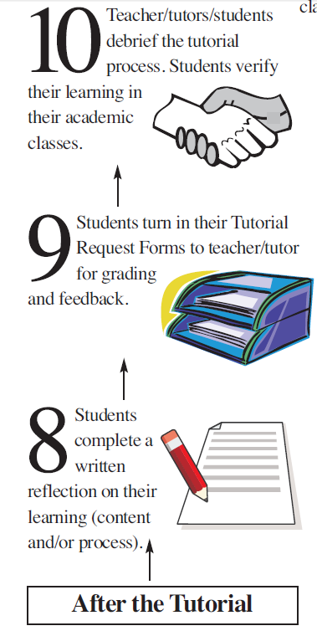
The Tutorial Process
Notes:
At the end of the tutorial, students complete a reflection on their learning.

Slide 8
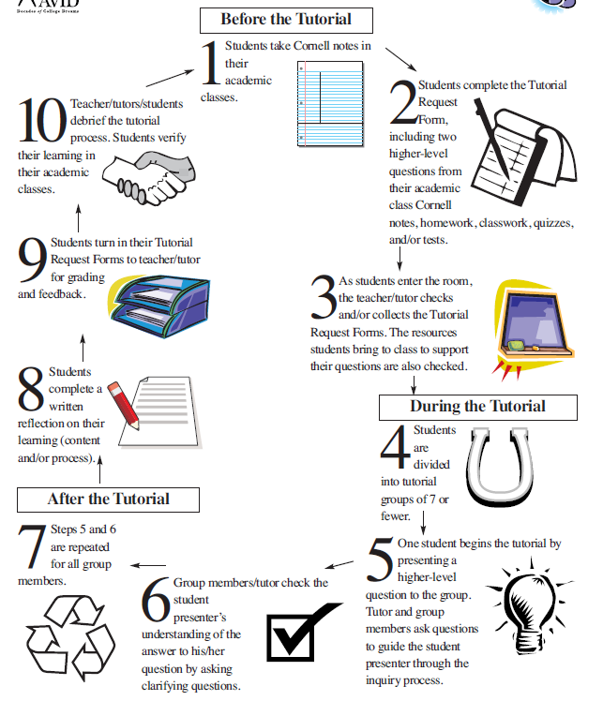
The Tutorial Process
Notes:
Although AVID students follow this process in tutorials every Tuesday and Thursday, the steps of identifying a point of confusion, asking questions, and identifying resources to get to the Ah-Ha! Moment become routine, so we can use this process when we are in other study groups or studying at home.

Slide 9
Debrief
Students:
Take out the 3 most recent graded TRF’s
Explain the process of how you complete a TRF. What do you do first, second,…
Parents:
Ask students to explain how well they use tutorials as a resource. How often do they volunteer to go to the board? Do they always bring an important question?
Notes:
AVID Students: Open your binder to your AVID section and go to your TRF subdivider. Please take out the 2 most recent graded TRF’s. Explain to your parent how we complete a TRF for homework.
Parents: Review the graded TRF’s with your son/daughter. Discuss the questions listed on the screen.

Slide 10
Thank You for Coming!
Palmermiddleschoolavid.weebly.com
More support available at AVID in the AM every Wednesday @ 8:15
Notes:
We’ve included the steps in the Tutorial Process in your handout along with some suggestions of how to use these steps at home with your student.
Do you have any questions?
(answer any questions the group has)
For more information and resources, please visit our school AVID website at www.palmeravid.org
Thank you for coming!

