Slide 1
Turn Over a New Leaf
for Organization Relief: One Student – One Binder!
Notes:
Good Evening , My name is
I am a ______ grade AVID Student
I’m a future graduate of ______ college or I am a future ______ (career).
We’re going to Turn Over a New Leaf for Organization Relief in the Binder Organization workshop!

Slide 2
In this session you will:
Understand the purpose of “One Student, One Binder!”
Learn how to support your child’s organization at home.
Evaluate your child’s binder using our rubric.
Notes:
By the time you leave this workshop you will
understand the purpose of “One Student, One Binder!”
Discover how to best support your son or daughter’s organization at home
Evaluate your son/daughter’s organizational system and uncover areas for growth

Slide 3
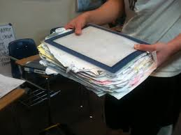
Before and After
Notes:
This is how AVID transforms a student’s organization!
The purpose of the “One Student, One Binder” is to ensure that students are organized in all aspects of their academic life.
An organized binder guarantees that students have everything they need at all times.
Pens and pencils are ready at a moments notice;
paper is available for assignments,
and notes and study guides are easily located for study sessions.

Slide 4
Organization as easy as 1-2-3
A place for everything; everything in its place.
Pencil pouch with all necessary supplies
Agenda in front
Divided and arranged in the order of your classes
Sub dividers where appropriate
Interactive Notebooks (INBs)
No Paper in POCKETS!!!
Take 5 minutes a day to put it all away!
Notes:
I will show you my own binder as an example to see how binder should be organized.

Slide 5
Agenda
Notes:
Binders are not the only way AVID students stay organized.
To prepare for tests and projects, we use backwards planning and our agendas.
Not only are we writing what we are doing each day into our agenda,
we are actually USING our agenda to plan ahead.
If we know we have a test in a week, we decide when, what, and how we will study in the days leading up to it (for more ideas about using the agenda to plan for success, please visit our agenda breakout session)

Slide 6
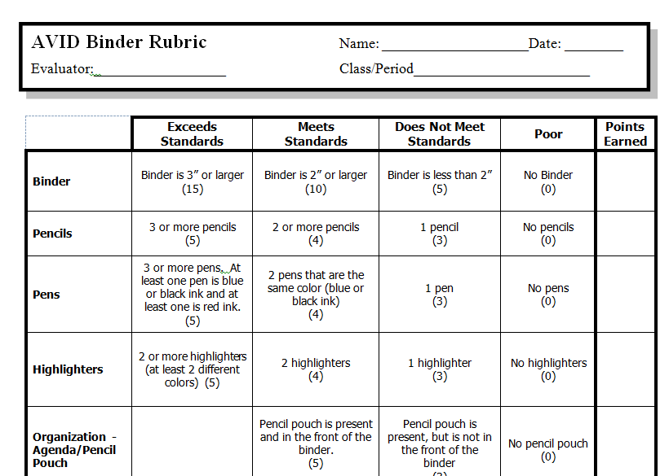
Binder Rubrics
6th Grade and Families New to AVID
7th & 8th Grade AVID Students (includes notes)
Notes:
To make sure students keep their binders organized,
we have a weekly binder check on Fridays, for AVID students.
If you’re not in AVID, or need extra organizational support, consider joining us at AVID and the am every Wednesday at 8:15. Also the binder rubric is on the website, if you want to test your students binder ability.
We use an AVID Binder Rubric that provides a checklist for us, so we can see what we need to have in our binders to be better prepared for our classes and our tests.
You will notice that we have a rubric for 6th grade and a rubric for 7th and 8th grade.
This is because the 7th and 8th grade students are required to have Cornell Notes in their binder.
Our 6th grade AVID students are still learning how to refine their Cornell Notes.
They will eventually be ready to have them as a required part of their weekly binder checks.
Now, it’s time to see how well your AVID student’s binder is organized.
AVID students, select the rubric for your grade level and use it to check your binder with your parents.
Take your time, and please ask questions as you use the rubric to evaluate the binder

Slide 7
How Did Your Binder Measure Up?
Turn and Talk to your parents about how you scored.
What are you most proud of?
What is your biggest area for improvement?
What are your goals for having a more organized binder and agenda?
Notes:
Well, how did your binder measure up?
Turn and Talk with your parents about what you plan to do, to be better organized in 2015.
Remember, AVID in the A.M. meets every Wednesday morning at 8:15 if you need time to organize.

Slide 8
Thank You!
Palmermiddleschoolavid.weebly.com
More support available at AVID in the AM every Wednesday @ 8:15
Notes:
Please feel free to as for clarification or ask any questions you may have.

