Slide 1
Don’t Let Your Grades Fade Away, Backwards Plan Every Day!
Notes:
Good Evening , My name is
I am a ______ grade AVID Student
I’m a future graduate of ______ college / I am a future ______ (career).
Welcome to our session: “Don’t Let Your Grades Fade Away, Backwards Plan Every Day!”

Slide 2
In this session you will:
Learn how to use Backwards Planning to excel in all classes.
View exemplary student agendas & compare to your child’s agenda.
Practice Backwards Planning by participating in a mock day at Palmer Middle School.
Notes:
In the Don’t Let Your Grades Fade Away, Backwards Plan Every Day session you will:
Learn how to properly use your agenda to excel in academics.
See the agenda of AVID students who have utilized this skill in the past and presently.
Go through the “Four Corners” Simulation, which will help you understand the importance and helpfulness of the agenda and backwards planning in day-to-day academic life.

Slide 3
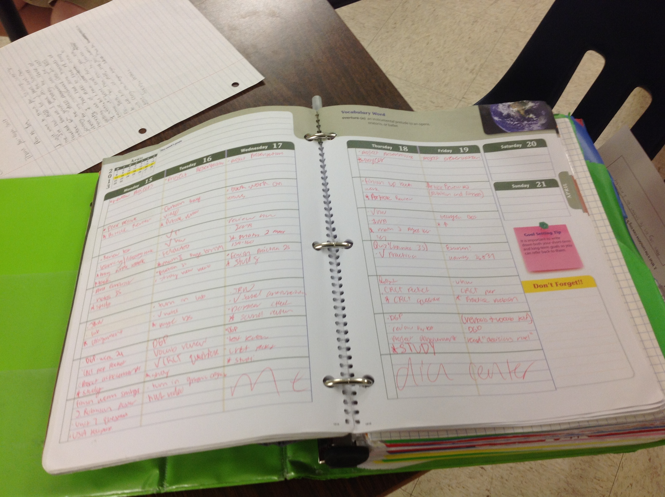
Backwards Planning
What is Backwards Planning?
Notes:
Binders are not the only way AVID students stay organized. To prepare for tests and projects, we use backwards planning and our agendas. Not only are we writing what we are doing each day into our agenda, we are actually USING our agenda to plan ahead. If we know we have a test in a week, we decide when, what, and how we will study in the days leading up to it.

Slide 4
How Do I Use Backwards Planning?
Plan ahead by writing everything you know about that class for the week.
Write details in between long term assignments.
Highlight important tests/quizzes so that they stand out and you do not forget them.
Notes:
Using an agenda is schoolwide expectation. All students are required to write in their agenda every day, in every class. However, AVID students don’t just record for one day. We plan ahead. You can backwards plan by writing all information for the week as soon as you get that information. So, for example, if you walk into science class on Monday, and the teacher says that there is a unit test on Friday, as instead of just writing it for one day and forgetting about it, AVID students fill in their agenda on every day of the week, on the day assigned, and the day the test is.

Slide 5
What Does It Look Like?
Mon.
Tues.
Wed.
Thurs.
Fri.
Finish
Write
Quiz
myself
Have
Unit test
Cornell
-
summary
(cover right
parents
Today!!!
notes in
for C
-
notes
side of
quiz me
•
Ecology
INB (revise,
notes and
from INB C
-
•
Food web/
create
Q’s)
write
notes
pyramid
Mult
•
.
Choice
answers)
•
Short
*reread all
answer
summaries
during HR
tomorrow!
Notes:
This is how I would use backwards planning if I walked into science class on Monday and the teacher announced a test.
First I would open my agenda flat so I can see the whole week
Next I would write down the test in a bright color on the day of the test. I would also include any important details that the teacher provides including what will be on the test and what type of test it will be
Then I would create a plan that would lead to my success.
Notice that the early days in my plan involve working on my Cornell-notes in my INB (or interactive notebook)
Also note that the last few days of my plan include a variety of active study strategies (not just staring at or rereading my notes)

Slide 6
Four Corners: Agenda Activity
Create groups
Go to the corner with your number
For each class, you will have 2 minutes to backwards plan in your agenda, make sure to list all assignments
Next, rotate when time is called to do next class and repeat
Notes:
Four corners is an activity that will help you understand how to properly use an AVID agenda. This will also in teach you how to help your AVID student keep up with their assignments for the week. (please note that you will need a pencil, pen and highlighter for this activity.) To start things off, we will divide you into four groups and send each group to a corner. Each corner will represent a different academic class period (Math, Science Social Studies, and Language Arts). Once you are in your corners, you will have two minutes to fill out you agenda for the week according to the assignments written on that class’s white board. After time is called, you will be asked to rotate clockwise to your next class period. This process will repeat until everybody has been to each class period.

Slide 7
How did you do?
Compare your agenda to a real AVID student’s agenda, and see what you did well/ where you struggled.
This process will help you further understand the AVID agenda process.
Notes:
Once you are back in your seats, we will come around, showing you our agendas and comparing them to your and your student’s agenda. While we are at your tables, feel free to ask questions to us about how you can better help your student use their agenda.

Slide 8
Math
Mon.
Tues.
Wed.
Thurs.
Fri.
Do workbook page 237 numbers 1-15 tonight

Slide 9
Language Arts
Mon.
Tues.
Wed.
Thurs.
Fri.
Quiz on Weds
Finish Cornell notes
Quiz over nouns and pronouns
Multiple choice
1/2 written response
Quiz tom
Study and review all C-notes

Slide 10
Science
Mon.
Tues.
Wed.
Thurs.
Fri.
Project due Friday- poster or power point on the water cycle- needs color
Finish Cornell notes
Water cycle poster/presentation due
Water Cycle Project due Friday
Gather supplies
Water Cycle Project due Friday
Begin putting poster together
Water Cycle Project due tom
Make final changes on poster

Slide 11
Social Studies
Mon.
Tues.
Wed.
Thurs.
Fri.
Economics Unit test on Thursday : multiple choice
Finish c-notes
Economics test Thursday.
Finish summary and questions on Cornell notes
Economics test tomorrow.
Create a study guide
Economics Unit Test today-all multiple choice

Slide 12
Thank You!
Palmermiddleschoolavid.weebly.com
More support available at AVID in the AM every Wednesday @ 8:15
Notes:
Are there any questions?
If you would like more resources on Cornell Notes, please visit our website @ www.palmermiddleschoolavid.weebly.com.
For more support, visit us every Wednesday morning at 8:15 in the AVID classroom for AVID in the AM
Thank you for coming!

Slide 13
Don’t Let Your Grades Fade Away, Backwards Plan Every Day!
Notes:
Good Evening , My name is
I am a ______ grade AVID Student
I’m a future graduate of ______ college / I am a future ______ (career).
Welcome to our session: “Don’t Let Your Grades Fade Away, Backwards Plan Every Day!”

